Slide 1
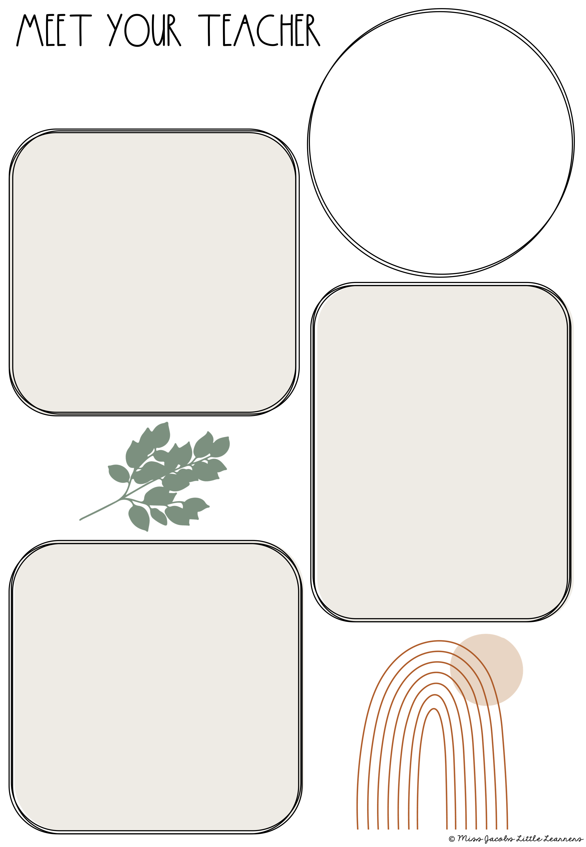
Mrs. Siebenmorgen
About Me
About ME
Hello! I am Mrs. Siebenmorgen! This is my eighth year teaching fourth grade here at Crestwood! I absolutely LOVE my job! I am also a mom to my daughter, Addy, and I have a puppy named Max.
favorites
Favorites
Drink- Coke Zero
Candy- Nerd Gummy Clusters
Color- Yellow
Animal- Panda
Restaurant- Buffalo Wild Wings or Monicals
Season- Winter
Store- Target and TJ Max
Education
Education
I graduated Indiana State University in 2015 with my degree in Elementary and Special Education. I also have a minor in Reading.

